Slide 1
InvenTree
GEMS December 2023
Project Mentor : Bhimashankar Gavkare
Group No: 14
Vivek Sharma
Aditya Tongse
Mansur Khan
Omkar Bansode
Shrikant Dhobale
Soham Badjate

Slide 2
Problem Statement:
Develop a Barcode Reading System using OpenCV to Automate Inventory Management for retail stores. The system will identify and categorize items using Barcodes on the product updating MySQL database via Flask APIs for Real-Time Inventory Tracking.

Slide 3
Approach / Solution:
A Web application using image processing library - OpenCV to identify the products, using the Barcodes on them. The system will keep track of products that Stocks-up and bought out from the inventory. After identification of the item, It will be stored/removed from the SQL database. An E-bill will be generated and shared with the customers via WhatsApp making paperless billing system.

Slide 4
Features:
Centralized data storage
Authentication and Authorization
Admin control
Product Scanning (Barcode Scanner using webcam)
Realtime Updates
Paperless Bill generation
User friendly interface
Dashboard with products details

Slide 5
Overall Progress:
Documentation Freeze
Wireframing completed
Frontend – 10 pages completed in total
Backend – Creating API’s
SQL – Database Connection and Schema’s created

Slide 6
Sprint – 0 & 1 Summary
Tasks Completed Tasks Pending (Backlog)
Problem Statement Understanding
Documentation Report assigned
  Class Diagram
  ER diagram
  Data Flow Diagram
  Architecture Diagram
  Sitemaps
  Use-Case Diagram
Software Installations
Database Creation
Tasks Completed
Start Working on API’s
Start Working on Frontend

Slide 7
Sprint – 2 Summary
Tasks Completed Tasks Pending (Backlog)
Started Working on API’s
  OTP Authentication
  User Permission
  E-bill
Testing API’s
  OTP Authentication
  User Permission
  E-bill

Slide 8
Sprint – 3 Summary
Tasks Completed
Testing API’s
  OTP Authentication
  User Permission
  E-bill
Frontend Pages

Slide 9
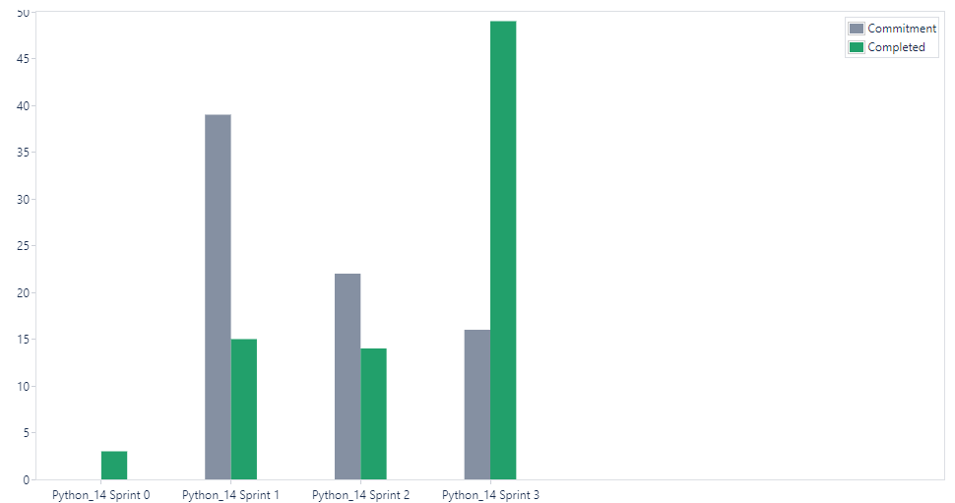
Overall Velocity Chart
Sprint | Commitment | Completed
0 | 0 | 3
1 | 39 | 15
2 | 22 | 14
3 | 16 | 49

Slide 10
Wireframes

Slide 11
User Stories

Slide 12
View Class DB
Relationship

Slide 13


